Slide 1
Overview of the “Barrier Approach”
to lower the upper bound of the
de Bruijn-Newman constant.
D.H.J. Polymath
July 2018
V1.6

Slide 2
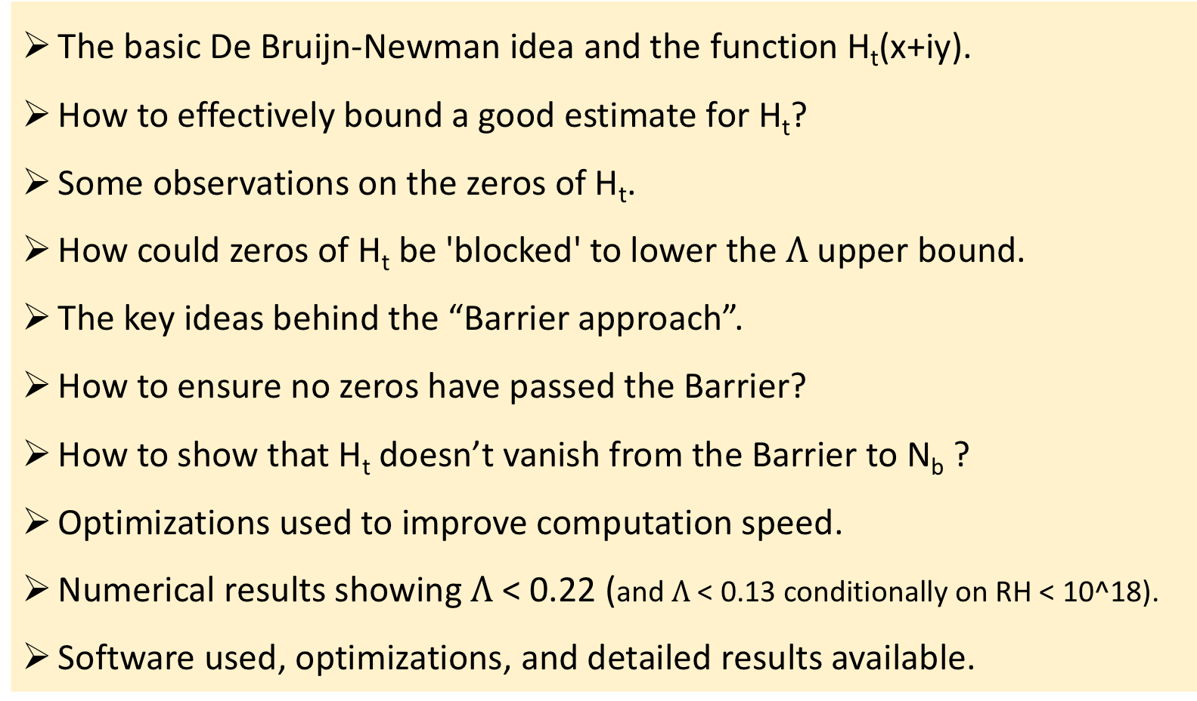
High level storyline
The basic De Bruijn-Newman idea and the function H_{t}(x+iy).
How to effectively bound a good estimate for H_{t}?
Some observations on the zeros of H_{t}.
How could zeros of H_{t} be 'blocked' to lower the $Λ$ upper bound.
The key ideas behind the “Barrier approach”.
How to ensure no zeros have passed the Barrier?
How to show that H_{t} doesn’t vanish from the Barrier to N_{b} ?
Optimizations used to improve computation speed.
Numerical results showing $Λ$ < 0.22 (and $Λ$ < 0.13 conditionally on RH < 10^18).
Software used, optimizations, and detailed results available.

Slide 3
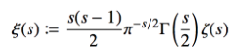
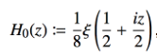
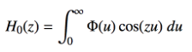
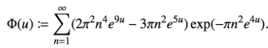
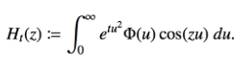

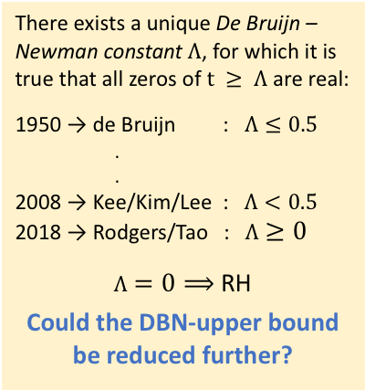

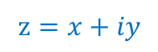



The idea behind the De Bruijn-Newman constant
$$iT$$
$$iy$$
$$s=σ+iT$$
$$z=x+iy$$
critical
strip
critical
strip
i
$$x$$
0
1
$$σ$$
0
Fourier
transform
-i
non-trivial zeros now on real
line, but stretched by factor 2.
New family of
entire functions
by De Bruijn
There exists a unique De Bruijn – Newman constant $Λ$, for which it is true that all zeros of $t ≥ Λ$ are real:
1950 → de Bruijn : $Λ≤0.5$
.
.
2008 → Kee/Kim/Lee : $Λ<0.5$
2018 → Rodgers/Tao : $Λ≥0$
$Λ=0⟹$ RH
Could the DBN-upper bound be reduced further?
First step: develop an effectively bounded estimate.

Slide 4
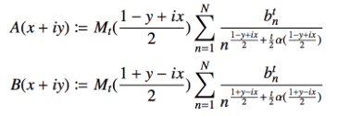
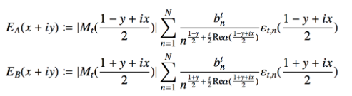
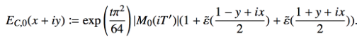
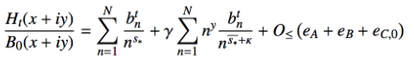
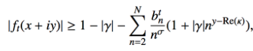
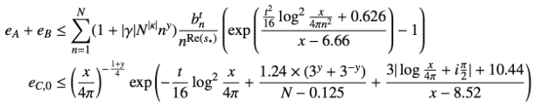
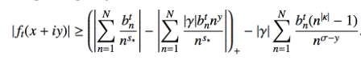
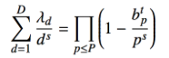

Estimating and effectively bounding H_{t}(x+iy)
Main estimate
Error terms
Designed for:
Optionally: a more effective C-term is available
Normalize by B₀ and bound effectively
Main estimate lower bound
Error upper bounds
(triangle)
Hence,
(lemma)
If Lower bound $≥$ Upper bound then
Choice of ‘Euler mollifiers’
then Ht ne 0

Slide 5
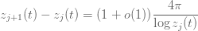
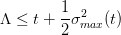
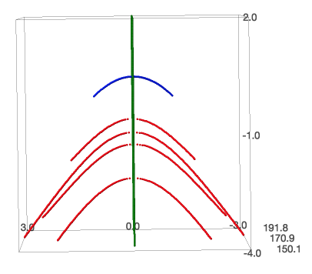
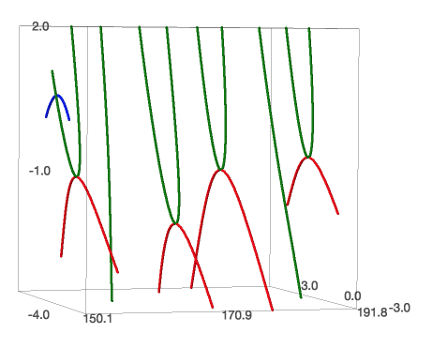
Actual trajectories of real and complex zeros of H_{t}(x+iy)
The complex parts of zeros attract each other and the real parts repel each other. From isolating the imaginary “force”, it can be derived that all complex zeroes will be forced into the real axis in a finite time leading to the bound:
Zeroes get denser as one moves away from the origin, so there are more zeros to the right of x_{n} then to the left, hence their trajectories typically “lean” leftwards.
Once a zero becomes real, it stays real forever and ends up roughly equally spaced with:
“solid”
state
0.5
0
0
“liquid”
state
-1
1
t
t
“gaseous”
state
y
x
y
x
trajectory of a complex zero
trajectory of a real zero

Slide 6
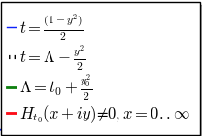

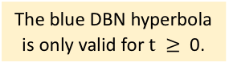
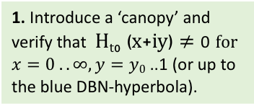
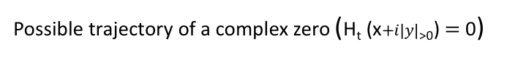
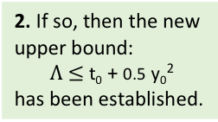
The De Bruijn – Newman $Λ$: introducing a ‘canopy’ the complex zeroes can’t cross
1. Introduce a ‘canopy’ and verify that H_{t0} (x+iy) $≠$ 0 for $x=0 ..∞,y=y0$ ..1 (or up to the blue DBN-hyperbola).
no complex
zeros
no complex
zeros
no complex
zeros
no complex
zeros
no complex
zeros
no complex
zeros
2. If so, then the new upper bound:
$Λ$ $≤$ t₀ + 0.5 y₀²
has been established.
The blue DBN hyperbola is only valid for $t ≥$ 0.
no complex
zeros
no complex
zeros
x₃
x₄
Complex zeros are “attracted” to their conjugates and “fall” to the real line with a lower bounded speed.
x₂
Even this extreme trajectory is theoretically possible since there is no upper bound on the speed by which zeros fall to the real line.
x₁
A “Lehmer pair”.
Possible trajectory of a complex zero (H_{t} (x$+i|y|$_{>0}) $=$ 0)

Slide 7

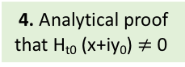
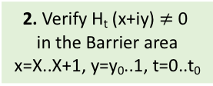
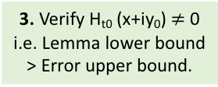
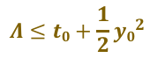
“ Barrier” approach to assure H_{t} (x+iy) $≠$ 0 for a certain y>y₀, t₀.
Numerical
verification
Analytical
proof
0.5
t₀
$$Λ≤t0+\frac{1}{2}{y0}^{2}$$
y₀
1
0
y
t
0
-1
-t
0
x
X
X+1
$$∞$$
N_{a}
N_{b}
1. Area where the RH has been verified e.g. 6x10¹⁰ certain, 10¹³ to be confirmed. Or assume that it has been verified up to X.
3. Verify H_{t0} (x+iy₀) $≠$ 0
i.e. Lemma lower bound
> Error upper bound.
4. Analytical proof
that H_{t0} (x+iy₀) $≠$ 0
2. Verify H_{t} (x+iy) $≠$ 0
in the Barrier area
x=X..X+1, y=y₀..1, t=0..t₀
Possible trajectories of complex zeros that should be “blocked”.

Slide 8
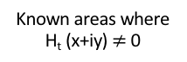
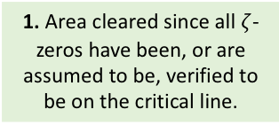
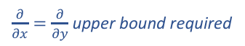
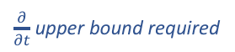

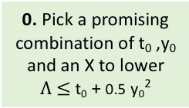
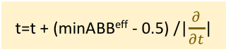
“Barrier” approach: how to clear the barrier?
t=t + (minABB^{eff} - 0.5) /|$\frac{∂}{∂t}$|
t
0. Pick a promising combination of t₀ ,y₀ and an X to lower
$Λ$ $≤$ t₀ + 0.5 y₀²
Known areas where
H_{t} (x+iy) $≠$ 0
t₀
3. Use an adaptive mesh to establish the optimal next t and continue with 2. until t=t₀.
0.5
$$Λ$$
$\frac{∂}{∂t}$upper bound required
1
y
0
1
Will be detected by barrier.
Y₀
Fast integral based
approach developed.
0
X
X+1
x
1. Area cleared since all $ζ$-zeros have been, or are assumed to be, verified to be on the critical line.
Can’t happen due to double barrier.
2. For a given t, clear rectangle X..X+1, y=y₀..1 (or a point on the hyperbola) using the argument principle and Rouché's theorem.
Location of Barrier can be optimized
by selecting an X and X+1 with a relatively high value of ABB^{eff} (and where the ‘mollified’ lower lemma bound is sufficiently positive).
$\frac{∂}{∂x}=\frac{∂}{∂y}$upper bound required
Available software tools:
Barrier_Location_Optimizer
Stored_Sums_Generator
WindingNumber_Calculator
Possible trajectories of complex zeros that should be “blocked”.

Slide 9

“Barrier” approach: how to verify the area from the barrier up to N_{b}?
3. Only the lower Lemma bound for the line y₀, t₀ needs to be verified to stay above the error bounds, since the Lemma bound monotonically increases for y going to 1.
t
0.5
$$Λ$$
y
t₀
1
2. A fast Approximate Triangle bound is used to establish the Nb point after which analytical proof takes over (currently ‘unmollified’, but prime 2 available).
y₀
0
X
X+1
x
N_{a}
N_{b}
1. Select a ‘mollifier’ that makes the Lemma bound sufficiently positive.
A fast “Sawtooth” mechanism has been developed, that only calculates the required incremental Lemma Bound terms and only requires a full calculation when the incremental bound passes a user defined threshold.
Available software tools:
N_{a}_Lemmabound_calculator
N_{b}_Location_Finder
LemmaBound_Sawtooth_calculator
Possible trajectory of complex zeros that should be “blocked”.

Slide 10
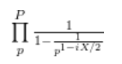
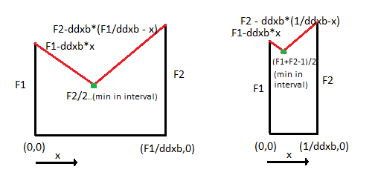
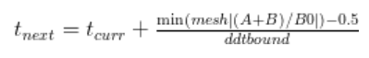
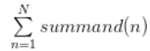
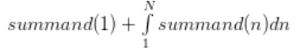
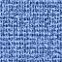
Optimizations made to improve computation speed
Barrier Optimizations
Euler Bounds Optimizations
Search for X interval where:
has large relative magnitude
|(A+B)/B0|
Using the incremental Lemmabound computations, as in section 8 of the writeup. When the incremental bounds reach a threshold (>> error bound), the full bound is recalculated.
1.
1.
X
Optimal Barrier Region
A larger t step:
is allowed due to a conservatively chosen mesh gap 1/ddzbound.
2.
Fast conservative error bound for [N_{min}, N_{max}].
N_{min} could also be reset at the beginning of a new sawtooth.
2.
The ddzbound and ddtbound are monotonous in X, y, t.
Hence replacing the slow ,
with numerically integrated fast conservative:
3.
0
1
N_{max}

Slide 11

The Barrier model - progress made
X-location where min_mesh|(A+B)/B0| starts between 4 and 5 at t=0 and ends near 1.5 at t=t₀.
Selected with the
LemmaBound utility
Selected with the
TriangleBound utility
1)
2)
1) Platt et al, 2011
2) Gourdon-Demichel, 2004

Slide 12
Software used and useful links
All software was developed in two languages and results between them were reconciled:
Symbolic math programming language - pari/gp (https://pari.math.u-bordeaux.fr )
Short development time
Relatively fast
Arithmetic Balls C-based library - Arb (http://arblib.org)
Longer development time
Very fast (up to 20 x pari/gp)
All software and results are free to use (under the LGPL-terms) and can be found here:
https://github.com/km-git-acc/dbn_upper_bound

